Slide 1
Anatomy of the Endocrine System
Asst Prof Jai Polepalli
jpolepalli@nus.edu.sg
Department of Anatomy
National University of Singapore

Slide 2
Scope
Pituitary gland
Thyroid Gland
Parathyroid gland
Adrenal gland
Pancreas

Slide 3
Endocrine system
Role of endocrine system is communication and regulation in response to
1. normal physiologic changes in the body
2. alterations in the external environment
to ensure body’s homeostasis
Distinct glands or tissues that secrete organic compounds or chemical messengers called hormones into the circulating system
These hormones stimulate or cause a change in metabolic activity in designated target tissues or organs

Slide 4
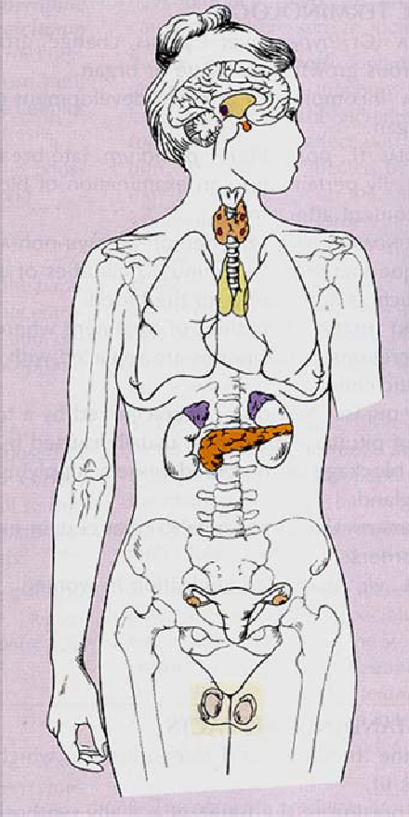
Principal endocrine glands
Hypothalamus, Pituitary, Pineal gland (Brain)
Thyroid and parathyroid (Neck)
Pancreas, Adrenals, gonads, placenta(Trunk)
GIT, Heart, Skin, Bone

Slide 5
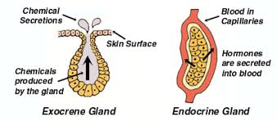
Hormones and its types
Biologically active substances released and transported in bloodstream
It may act on target organs ,paracrine or autocrine
Four major types – Peptide or protein , Steroids ,Tyrosine or amino derived and fatty acid derivatives

Slide 6
Endocrine gland
Rich blood supply with fenestrated capillaries
Cuboidal /columnar epithelium – secretory cells
Cells are arranged in cords or clusters
Supportive framework (connective tissue)

Slide 7
Pituitary gland (Master endocrine gland)

Slide 8
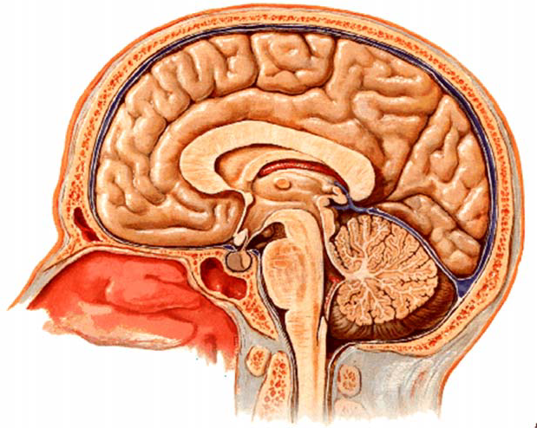
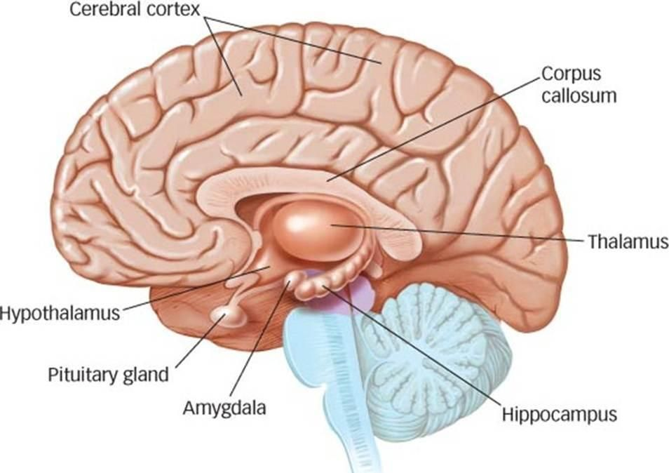
Pituitary gland
Hypothalamus
Hypothalamus and pituitary form a neuroendocrine unit

Slide 9
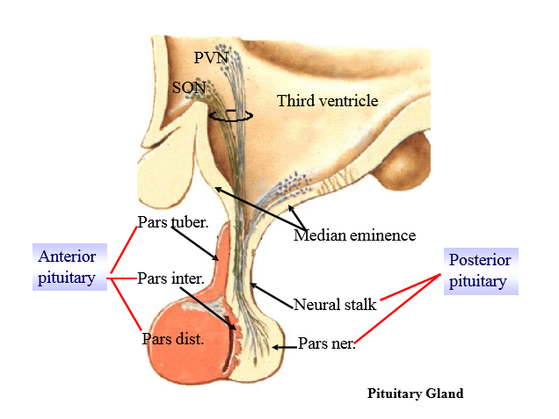

Slide 10
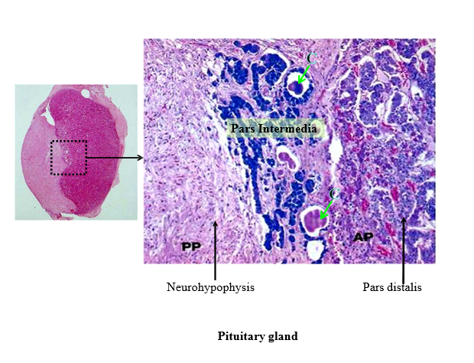
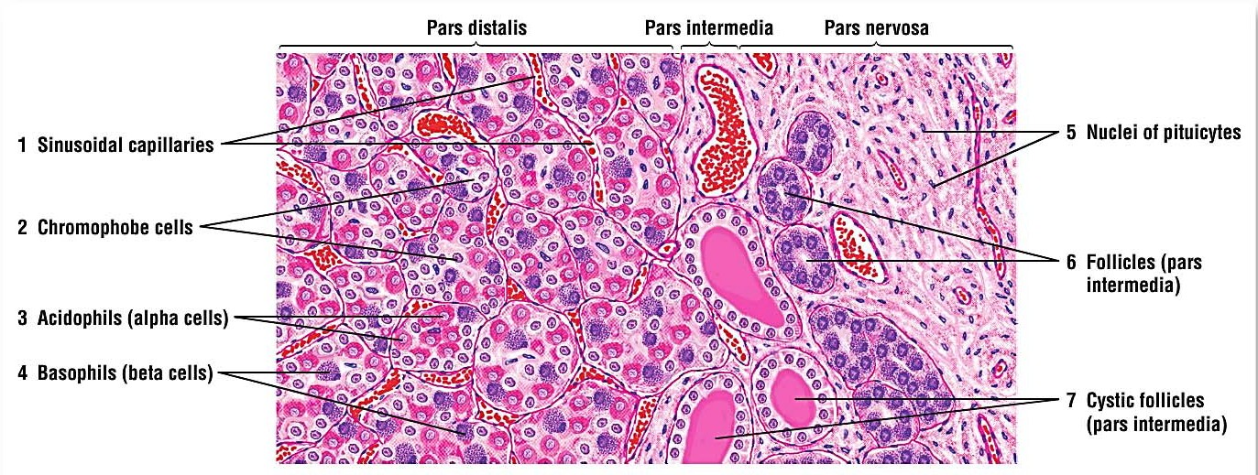

Slide 11
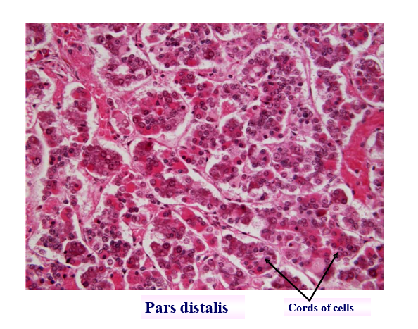
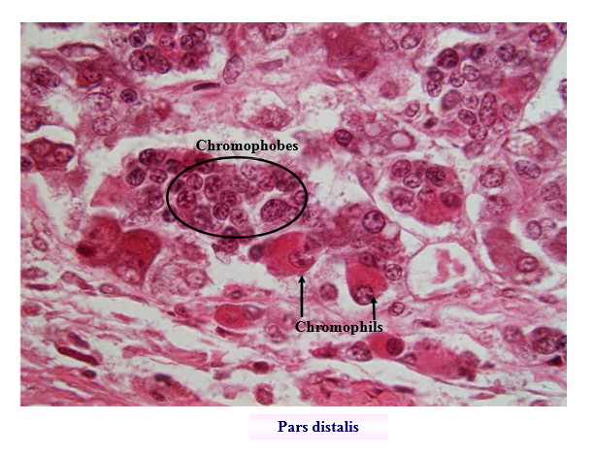
Adenohypophysis/anterior pituitary

Slide 12
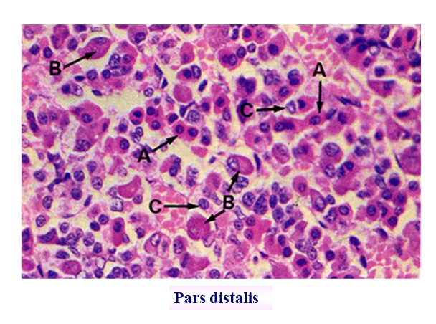
Adenohypophysis
Pars distalis
Chromophils (secretory cells in which hormone is stored in cytoplasmic granules)
Acidophils
Somatotrophs (growth hormone)
Mammotrophs (prolactin)
Basophils
Gonadotrophs (FSH, LH )
Corticotrophs (ACTH or corticotropin )
Thyrotrophs ( TSH )
Chromophobes (degranulated chromophil cells )
Pars intermedia
Melanotrophs
-Melanocyte stimulating hormone

Slide 13
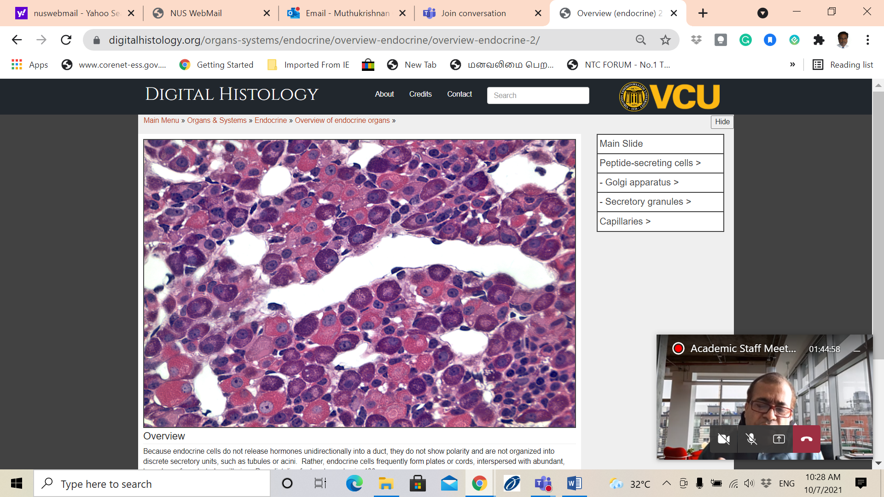
Pars distalis
Capillary
Basophil
Acidophil

Slide 14
Pars Tuberalis
Undifferentiated cells (gonadotrophs)
Many cells appear to be chromophobes
Some acidophils and basophils also present

Slide 15
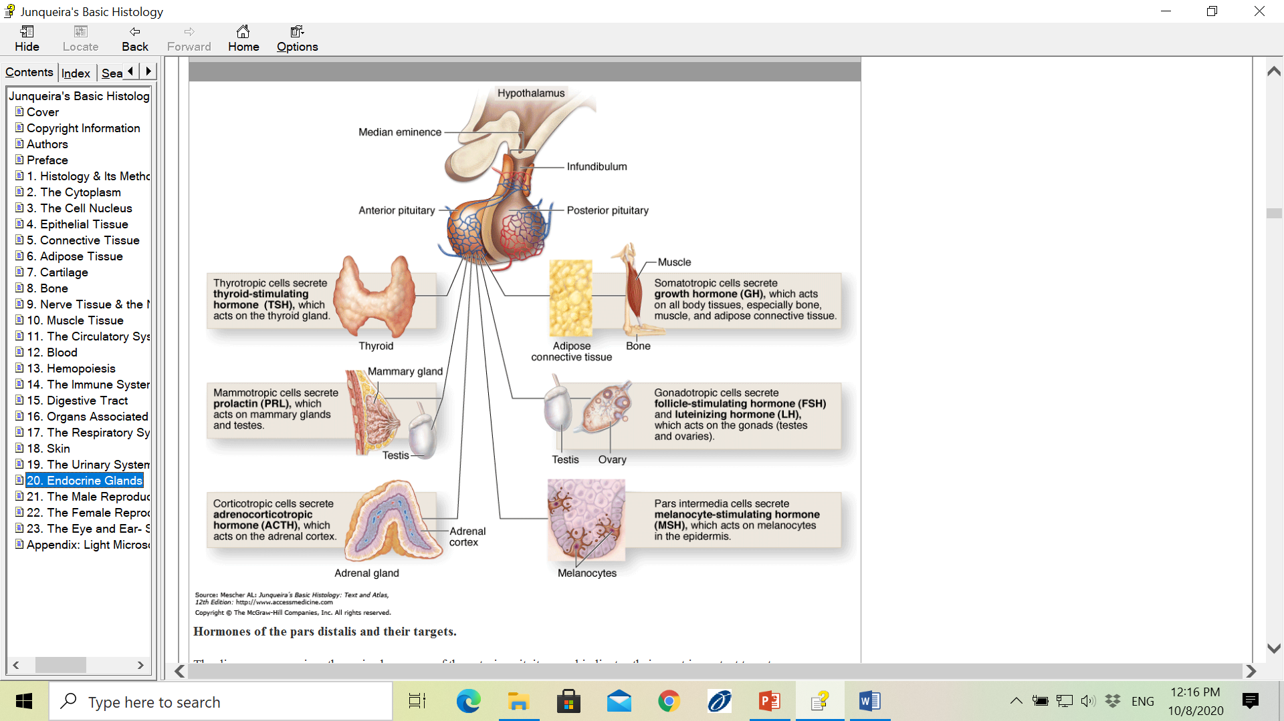

Slide 16
Neurohypophysis (Posterior pituitary or Pars Nervosa )
Axons of neurosecretory cells in supraoptic nucleus (SON) & paraventricular nucleus(PVN) of the hypothalamus
Pituicytes( supporting cells )
Herring bodies
A large number of capillaries present
Hypothalamic hormones - Antidiuretic hormone & Oxytocin are stored in neurohypophysis as granules in the axons

Slide 17
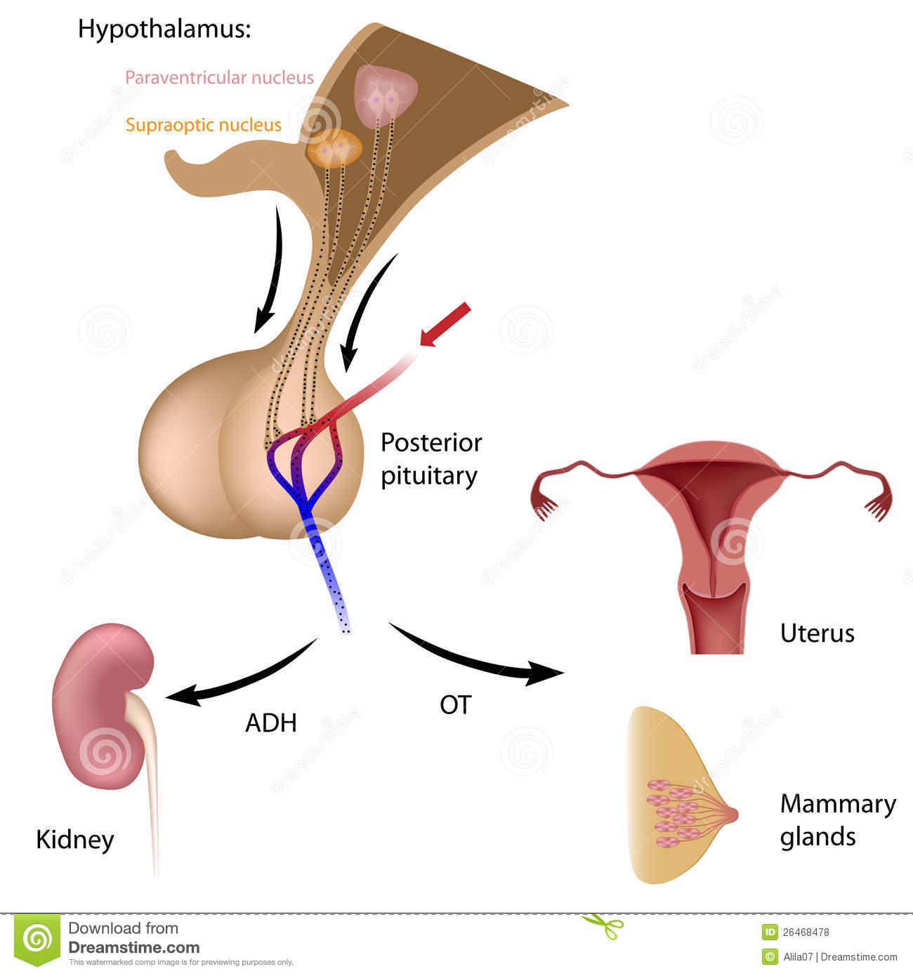

Oxytocin causes uterine contraction during labour and milk expulsion from mammary gland
ADH mainly acts on renal tubules ,reducing urinary flow by increasing water absorption

Slide 18
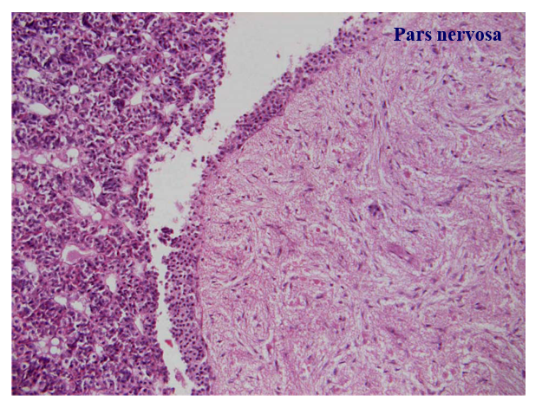
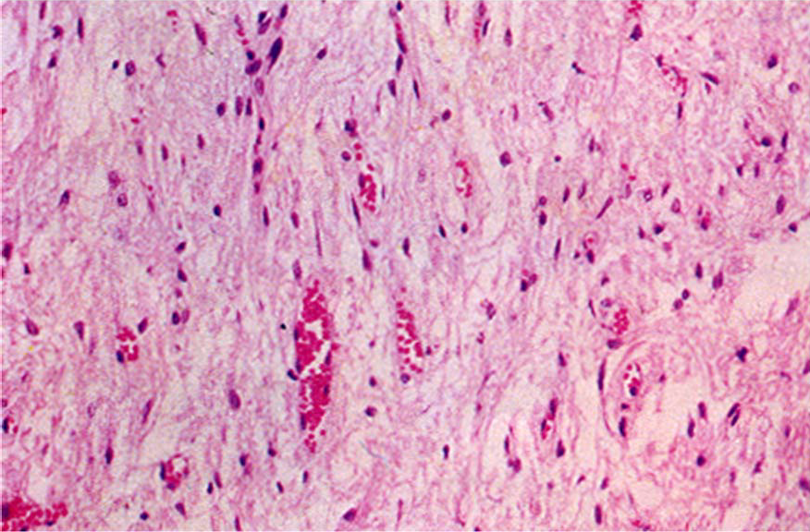
Pars nervosa

Slide 19
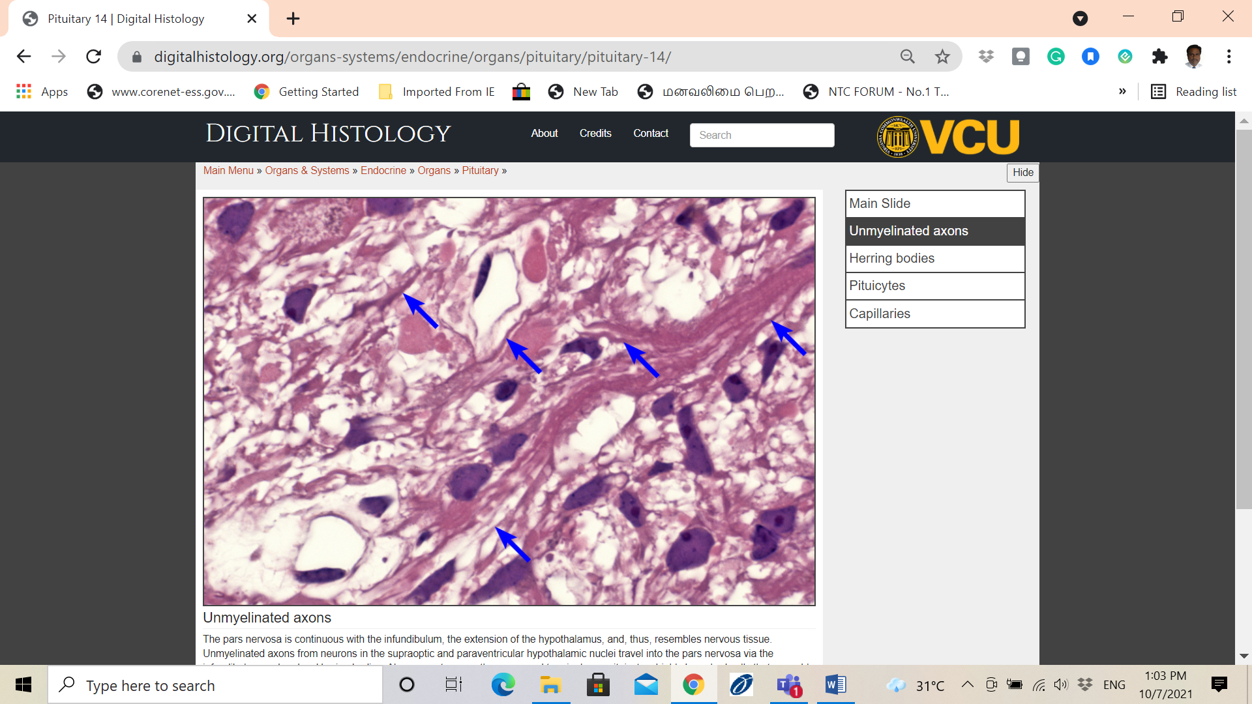
Herring body
Pituicytes
Blue arrows- unmyelinated axons of the Pars nervosa

Slide 20
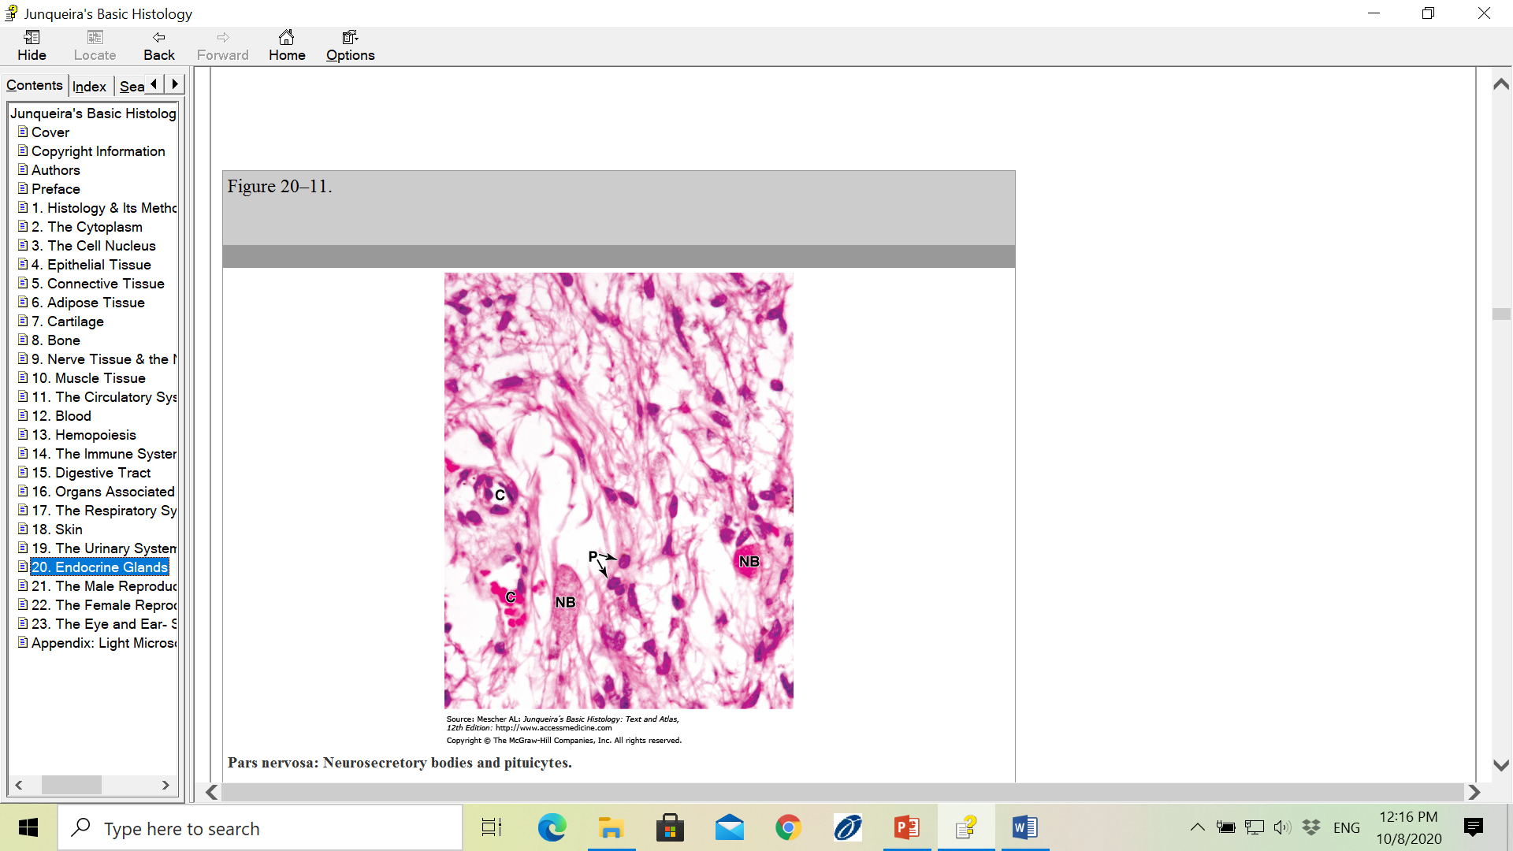
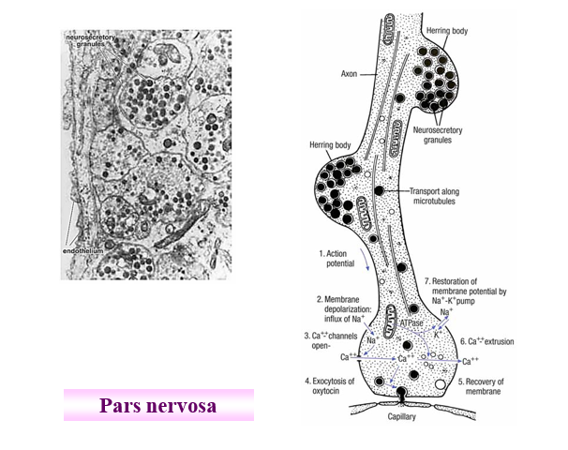
Glial cells or pituicytes ensheath the axons
Herring bodies

Slide 21
Thyroid and parathyroid glands

Slide 22
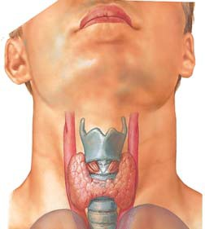
Thyroid gland
Located in anterior and inferior to the larynx in the region of neck
Butterfly shaped gland with two lobes connected by an isthmus
It has a capsule and richly supplied by superior and inferior thyroid arteries
Develops from foregut endoderm near the base of the developing tongue

Slide 23
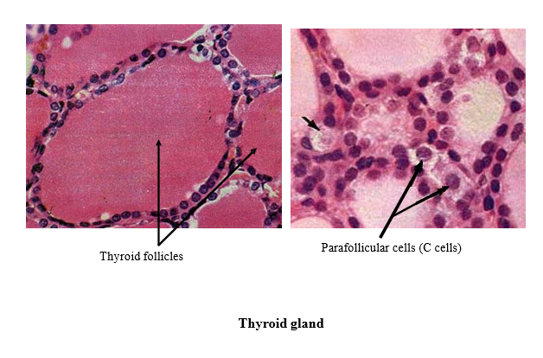
Millions of rounded epithelial follicles
Follicular cells – cuboidal to tall columnar type of cells(active or non active
Colloid contains thyroglobulin
Under TSH control
Parafollicular cells develop from the neural crest
Larger than follicular cells, stain less intensely
Secrete Calcitonin

Slide 24
Thyroid hormones and its control
Follicular cells-----Iodine containing hormones
Tri-iodothyronine (T3)
Thyroxine (tetra-iodothyronine (T4)
These hormones regulate basal metabolic rate (BMR) and influence growth and maturation of nervous tissue
Parafollicular cells -----Calcitonin
Regulates blood calcium level (lowers blood calcium level)

Slide 25
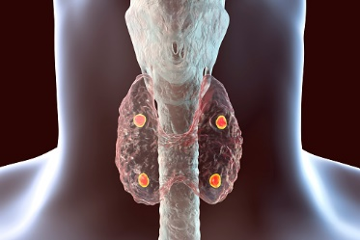
Parathyroid glands
4 ovoid masses lying on the posterior surface of the thyroid gland within its capsule
Secretes parathyroid hormone which raises blood calcium levels

Slide 26
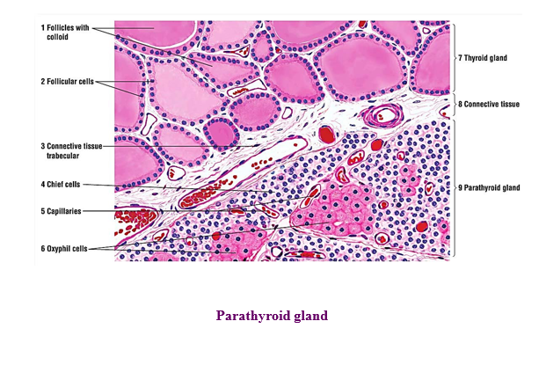

Slide 27
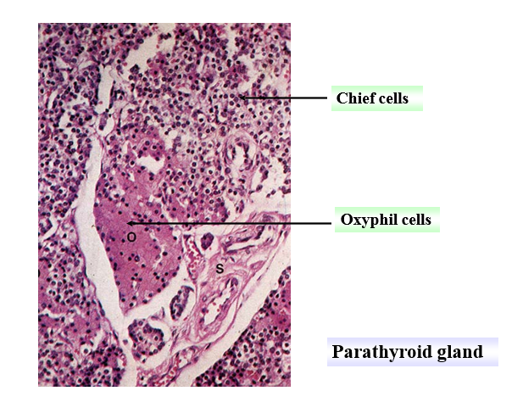
Small polygonal cells with round nuclei and pale staining cytoplasm

Slide 28
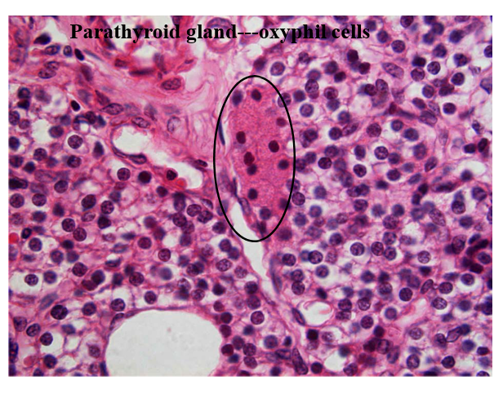
Oxyphil cells -Large cells , more acidophilic
Seen in old people – degenerated chief cells
Chief cells

Slide 29
Low serum calcium levels stimulates Chief cells to secrete Parathyroid hormone (PTH)
Increases osteoclastic activity in bones ----Release of Calcium into the blood
Increases calcium reabsorption in distal convoluted tubule of renal cortex and inhibits phosphate reabsorption in the PCT
Indirectly increases the Calcium absorption in the small intestine by stimulating Vitamin D absorption

Slide 30
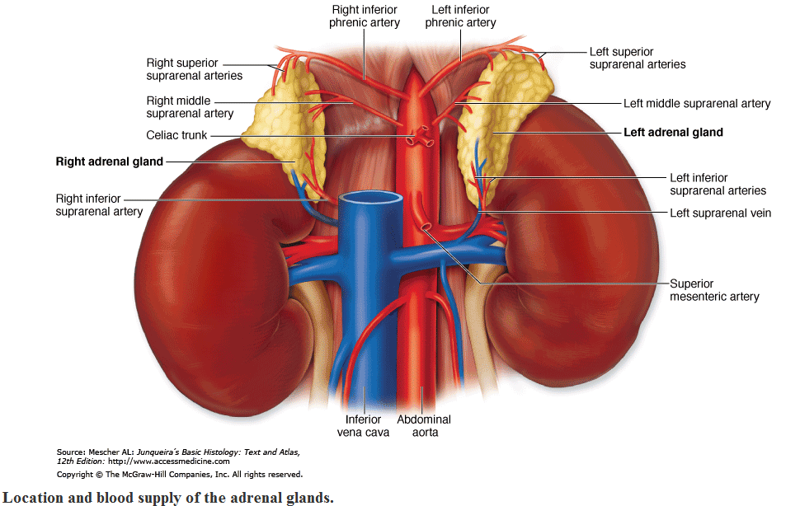
Adrenal glands

Slide 31
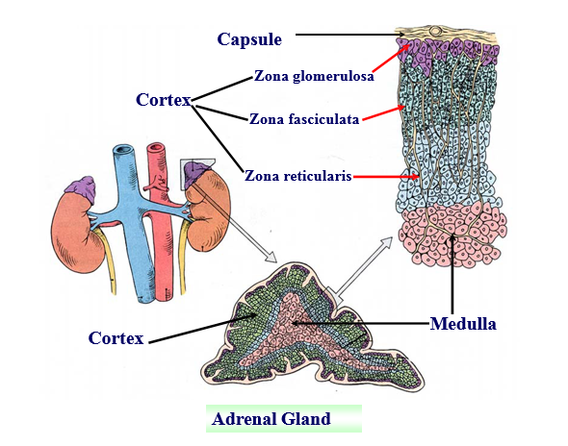
Adrenal glands maintain the constancy of the internal environment of the body
and make appropriate physiological changes in response to acute stress

Slide 32
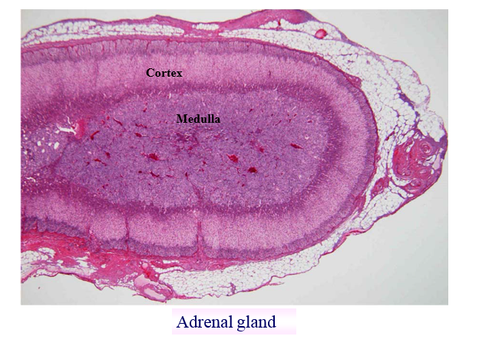

Slide 33
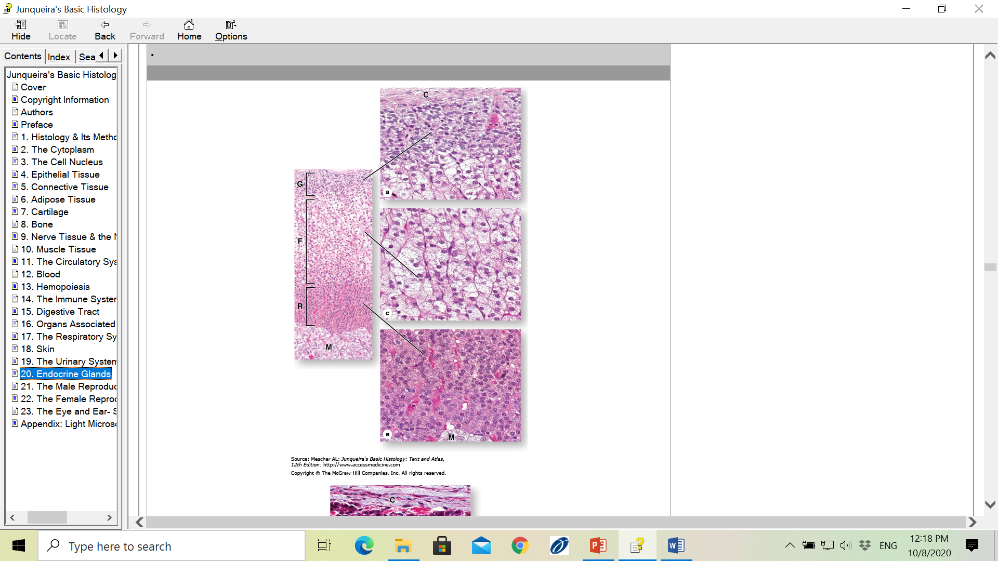
Zona Glomerulosa
Columnar or pyramidal cells,rounded or arched cords
Mineralocorticoids( aldosterone)—control water and electrolyte balance,controlled ONLY by renin angiotensin (kidneys)
Zona fasciculata
Long cords of large polyhedral cells with vacuolated appearance
Glucocorticoids(Cortisol)— have effects on carbohydrate, protein and lipid metabolism, suppress immune function,controlled by ACTH
Zona reticularis
Smaller cells with irregular cords, heavily stained
Dehydroepiandrosterone(Androgens) supplement gonadal sex hormone secretion. and cortisol in small amounts

Slide 34
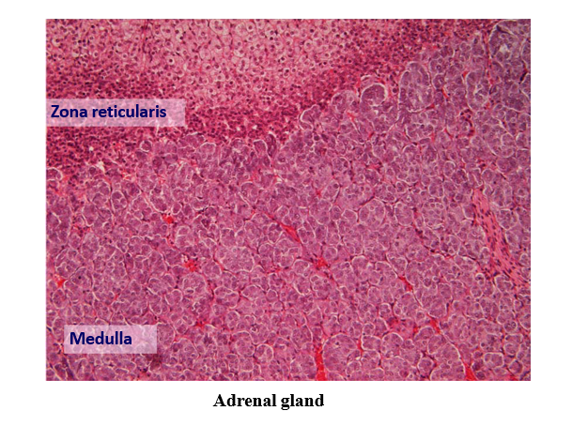
Adrenal medulla
Large pale staining polyhedral cells (in cords or clumps) –CHROMAFFIN CELLS
Have electron dense granules containing catecholamines
These cells are innervated by preganglionic sympathetic neurons that trigger the release of epinephrine and norepinephrine (Fight or Flight response)
These cells are considered to be modified postsynaptic sympathetic neurons

Slide 35
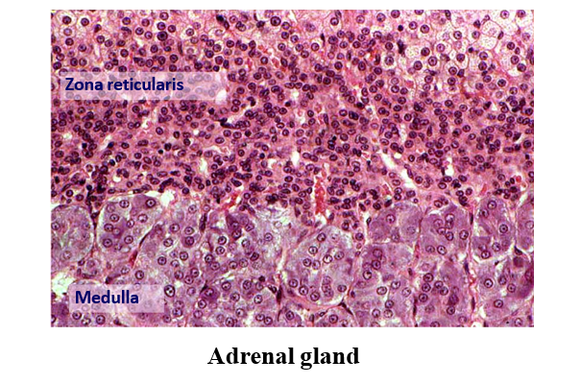
Large polyhedral and pale staining chromaffin cells

Slide 36
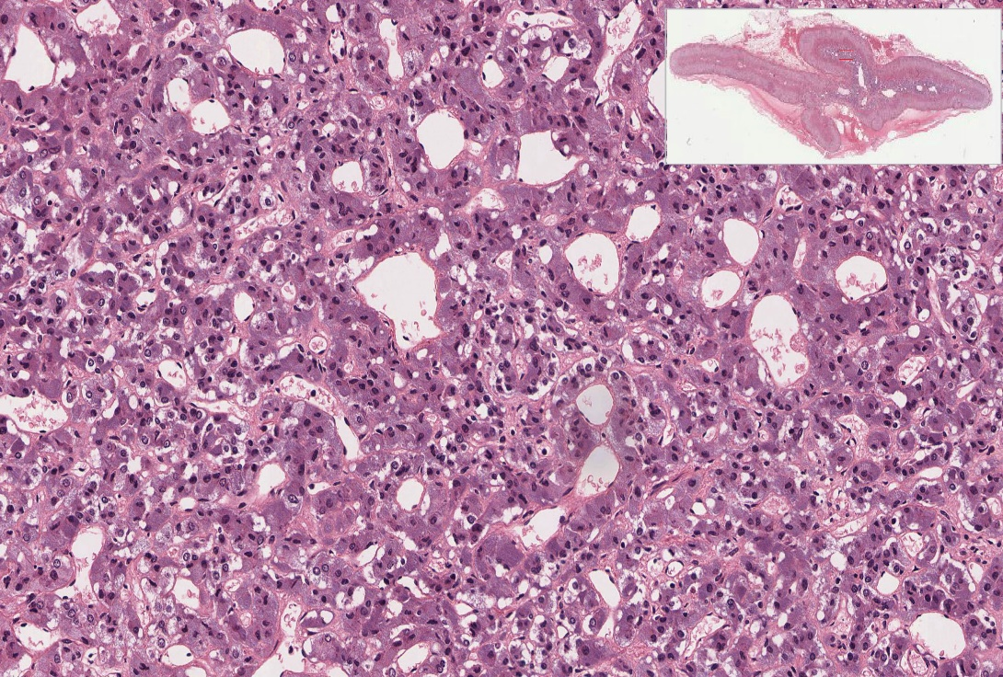
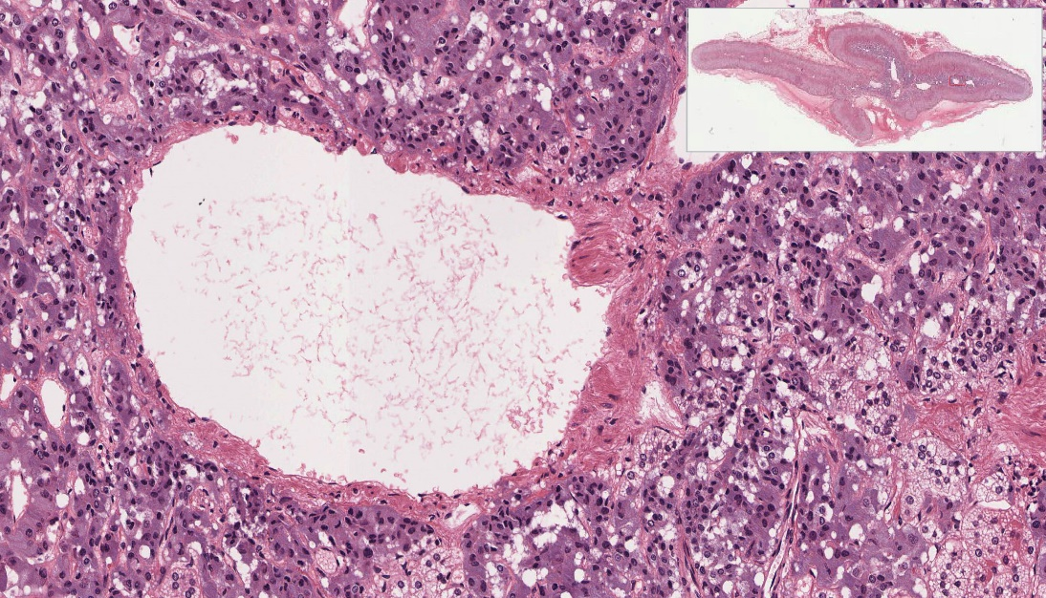
Adrenal medulla
Epinephrine increases heartrate , dilate bronchioles and dilates arteries of cardiac and skeletal muscle
Norepinephrine constricts vessels of the digestive system and skin , increasing blood flow to the heart , muscles and brain
Both these hormones cause glycogenolysis
Chromaffin cells
medullary vein

Slide 37
Adrenal Gland
Cortex
Zona Glomerulosa (mineralocorticoids)
Zona Fasciculata (glucocorticoids, adrenal androgens)
Zona Reticularis (glucocorticoids, androgens)
Medulla
Chromaffin cells
Ganglion cells
Epinephrine and norepinephrine produced

Slide 38
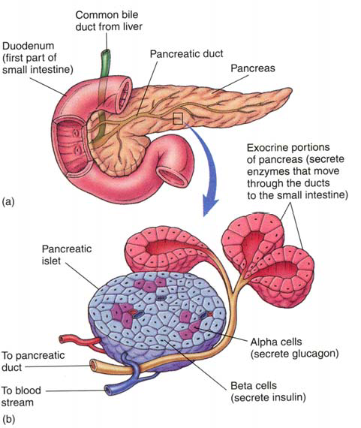
Pancreas ( Islets of Langerhans )

Slide 39
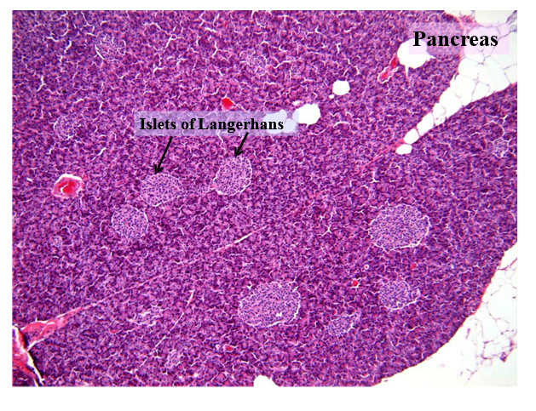
Islets of Langerhans(endocrine cells)
Compact spherical or ovoid masses of endocrine cells embedded within the acinar cells
(A thin reticular capsule surrounds each islet )

Slide 40
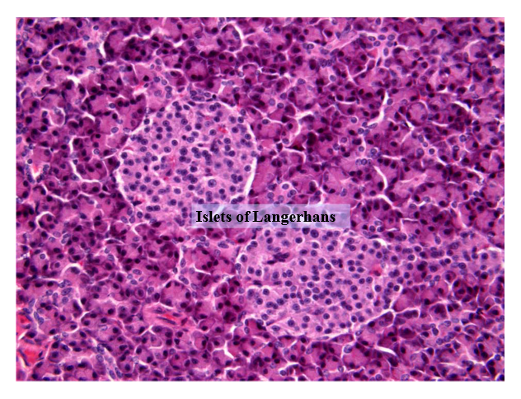
Endocrine cells appear rounded or polygonal,smaller and lightly stained than exocrine cells
These islets may be acidophilc or basophilic with cytoplasmic granules
Arranged in cords separated by fenestrated capillaries

Slide 41
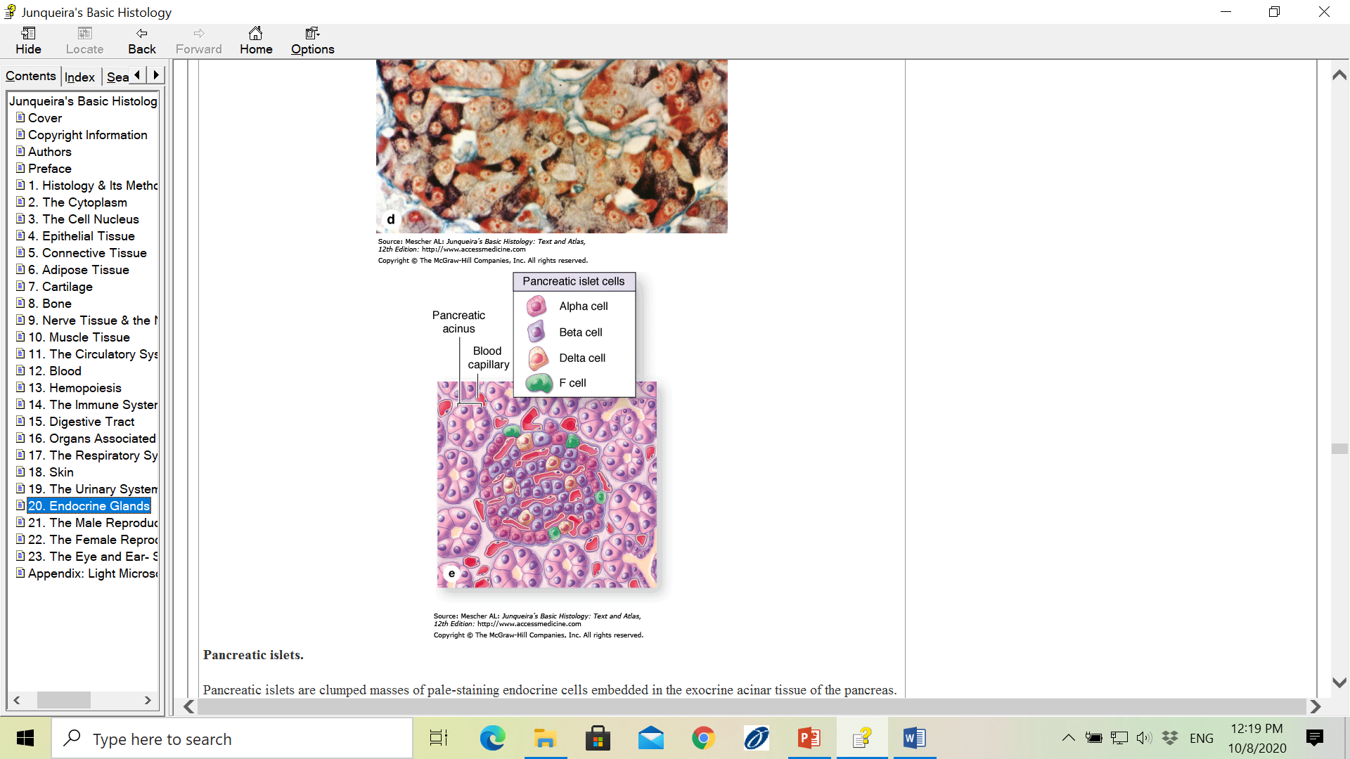
Islets of Langerhans
Which cell is affected in DIABETES MELLITUS ?

Slide 42
Type of cell | Hormone secreted | Functions of the hormone
Alpha cell (20%) | Glucagon | Increases blood glucose content , Acts on several tissues to make energy stored in glycogen and fat available through glycogenolysis and lipolysis
Beta cell (70%) | Insulin | Causes entry of glucose into cells and promotes decrease of blood glucose content
Delta cell(5-10%) | Somatostatin | It inhibits release of other islet cell hormones,inhibits GH and TSH from anterior pituitary and HCLsecretion from gastric parietal cells s
PP cell or F cell(1-2%) | Pancreatic polypeptide | Stimulates action of gastric chief cells ,decreases bile secretion , pancreatic secretion ,bicarbonate secretion and intestinal motility

Slide 43
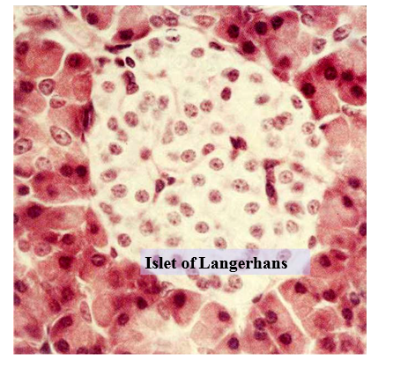
Islets of Langerhans
Glucagon---secreted in response to low blood glucose, effects are opposite to insulin
Insulin---secreted in response to high blood glucose (lowers blood glucose), enhances glucose uptake by most cells, B cell malfunction causes diabetes mellitus
Somatostatin---suppresses release of insulin, glucagon
Pancreatic polypeptide---inhibits secretion of pancreatic enzymes

Slide 44
Thank you

